Slide 1
How to filter by contents of a specific position of a control field in Alma Analytics
Yoel Kortick – Senior Librarian

Slide 2

Contents
  Introduction
  Filtering by pos. 35-37 of the 008 (language code)
  Filtering by pos. 6 of the LDR (type of record)

Slide 3

Introduction

Slide 4
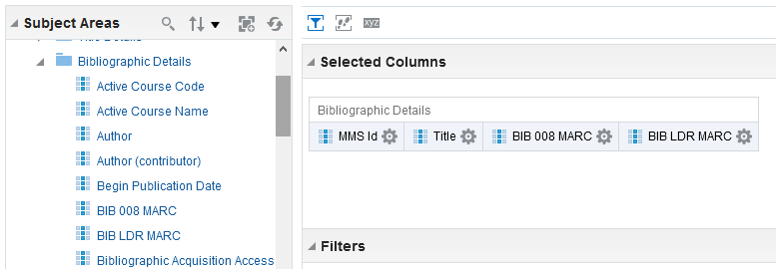
Introduction
The shared Bibliographic Details folder contains the full control fields 008 and LDR

Slide 5
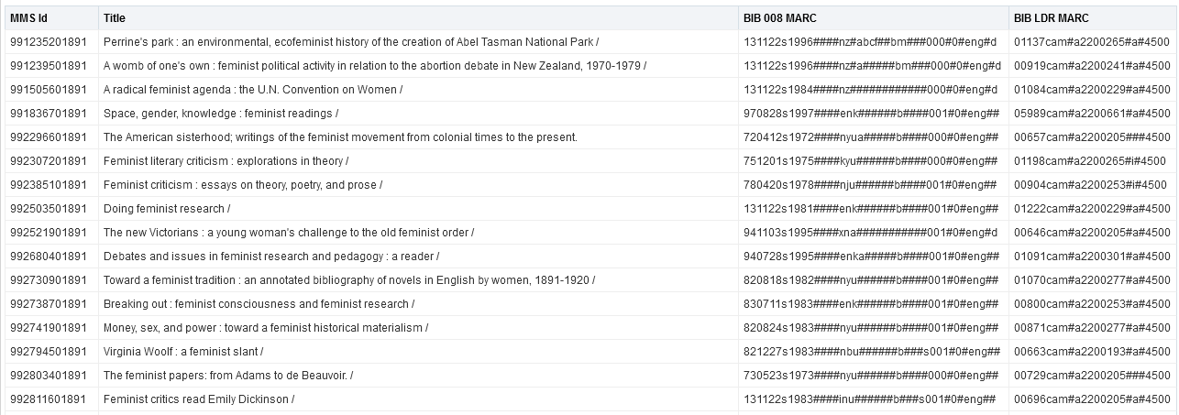
Introduction
For example

Slide 6
Introduction
There may be cases where a user wishes to retrieve all records which have a specific character in a certain position (or positions) of the control field.
For example:
  All records which have “fre” in position 35-37 of the 008 (meaning that the language is French)
  All records which have “c” in position 6 of the LDR (meaning that the type of record is Notated Music)
In this presentation we will show how this can be done.

Slide 7

Filtering by pos. 35-37 of the 008 (language code)

Slide 8
Filtering by pos. 35-37 of the 008 (language code)
When LOC (Library of Congress) counts positions in a fixed field the count starts at 0.
When OBI (Oracle Business Intelligence) queries positions on a string it start at 1
Therefore:
  LOC determines that the language code is in positions 35, 36 and 37.
  OBI determines that the language code is in positions 36, 37 and 38.

Slide 9
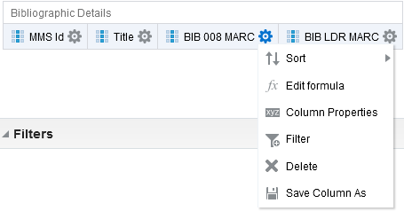
Filtering by pos. 35-37 of the 008 (language code)
We will now show how to get only positions 36, 37 and 38 of the 008 and then how to filter on it.
Step 1: Do “edit formula” on field "BIB 008 MARC"

Slide 10
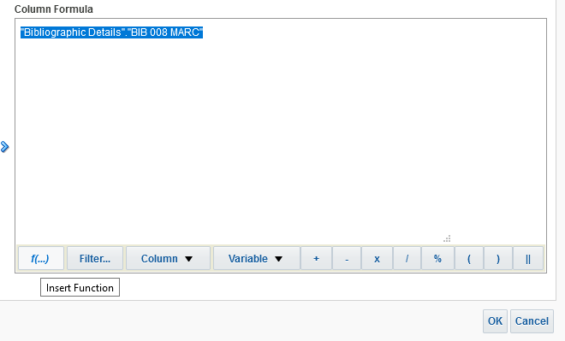
Filtering by pos. 35-37 of the 008 (language code)
Step 2: Insert a function on field "BIB 008 MARC"

Slide 11
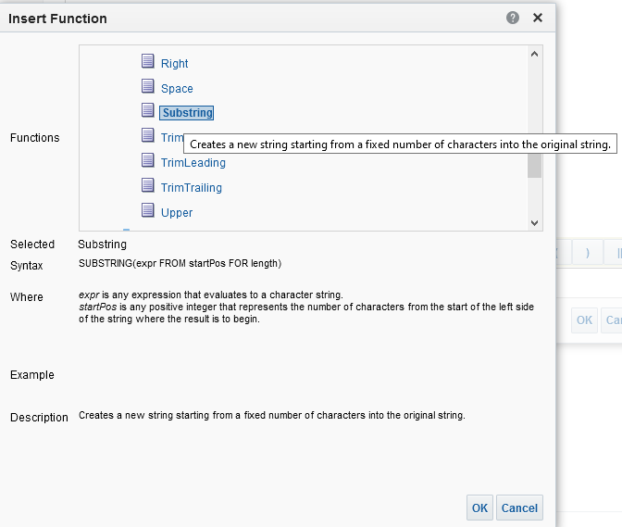
Filtering by pos. 35-37 of the 008 (language code)
Step 3: Choose “Substring” (which appears under the section “String”)
This will change the contents of the field to be a template for getting a specific substring

Slide 12
Filtering by pos. 35-37 of the 008 (language code)
Step 3:
Change
SUBSTRING("Bibliographic Details"."BIB 008 MARC" FROM startPos FOR length)
to
SUBSTRING("Bibliographic Details"."BIB 008 MARC" FROM 36 FOR 3)
Note: “36 FOR 3” means “Positions 36, 37 and 38”

Slide 13
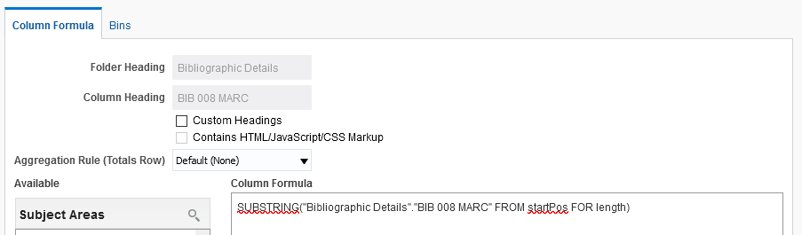
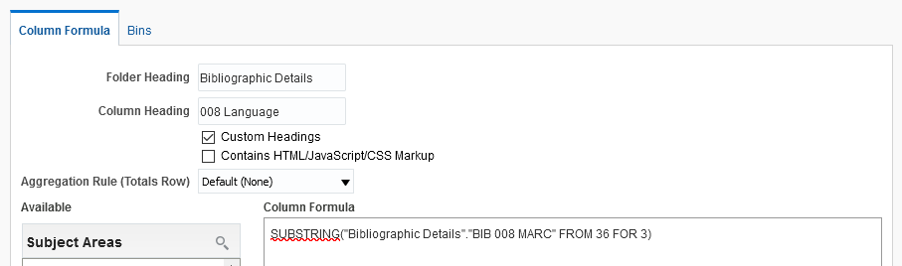
Filtering by pos. 35-37 of the 008 (language code)
Before
A template for getting a specific substring
You may want to rename the column. Here we call it “008 language”
After
This will bring the specific substring

Slide 14
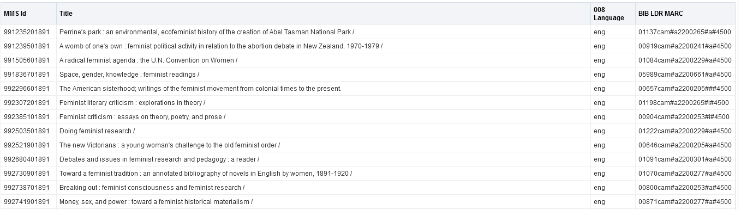
Filtering by pos. 35-37 of the 008 (language code)
Step 4: Confirm that you have the desired position(s)

Slide 15
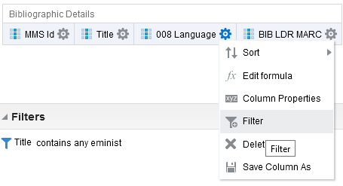
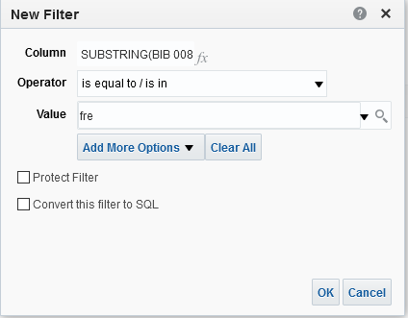
Filtering by pos. 35-37 of the 008 (language code)
Step 5: Perform the filter

Slide 16
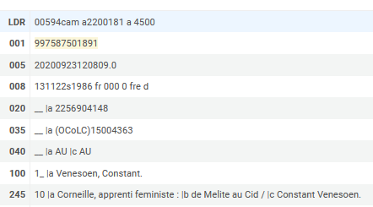
Filtering by pos. 35-37 of the 008 (language code)
See results
This is the record viewed in Alma

Slide 17


Filtering by pos. 6 of the LDR (type of record)

Slide 18
Filtering by pos. 6 of the LDR (type of record)
When LOC (Library of Congress) counts positions in a fixed field the count starts at 0.
When OBI (Oracle Business Intelligence) queries position on a string it start at 1
Therefore:
  LOC determines that the type of record code is in position 6.
  OBI determines that the type of record code is in position 7.

Slide 19
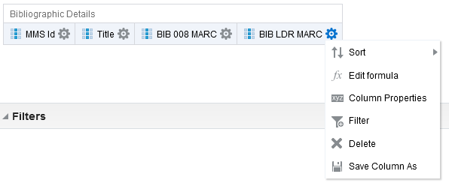
Filtering by pos. 6 of the LDR (type of record)
We will now show how to get only position 7 of the LDR and then how to filter on it.
Step 1: Do “edit formula” on field "BIB LDR MARC"

Slide 20
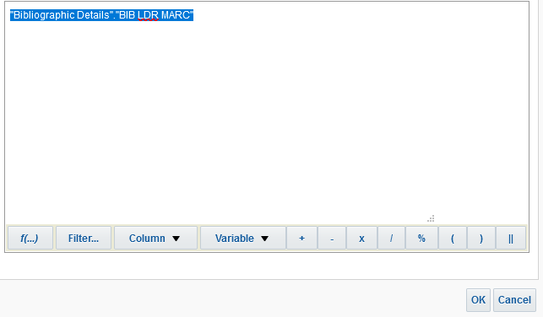
Filtering by pos. 6 of the LDR (type of record)
Step 2: Insert a function on field "BIB LDR MARC"

Slide 21
Filtering by pos. 6 of the LDR (type of record)
Step 3: Choose “Substring” (which appears under the section “String”)
This will change the contents of the field to be a template for getting a specific substring

Slide 22
Filtering by pos. 6 of the LDR (type of record)
Step 3:
Change
SUBSTRING("Bibliographic Details"."BIB LDR MARC" FROM startPos FOR length)
to
SUBSTRING("Bibliographic Details"."BIB 008 MARC" FROM 7 FOR 1)
Note: “7 FOR 1” means “Position 7”

Slide 23
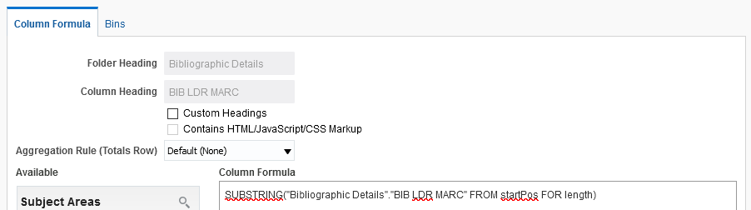
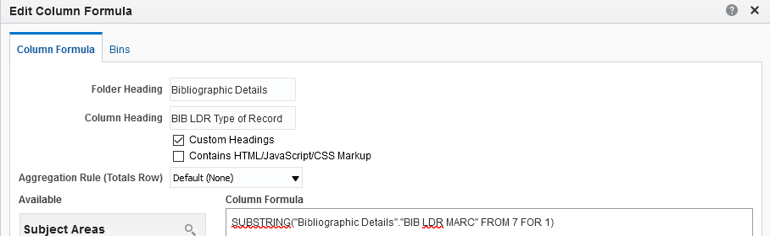
Filtering by pos. 6 of the LDR (type of record)
Before
A template for getting a specific substring
You may want to rename the column. Here we call it “BIB LDR Type of Record”
After
This will bring the specific substring

Slide 24
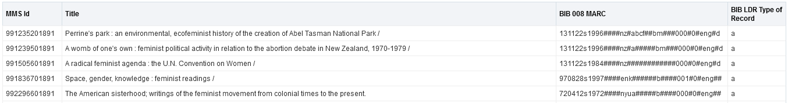
Filtering by pos. 6 of the LDR (type of record)
Step 4: Confirm that you have the desired position(s)

Slide 25
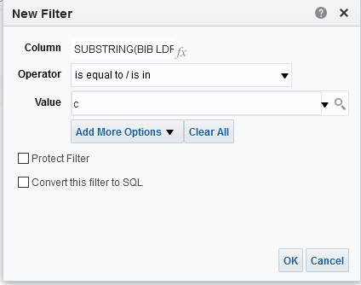
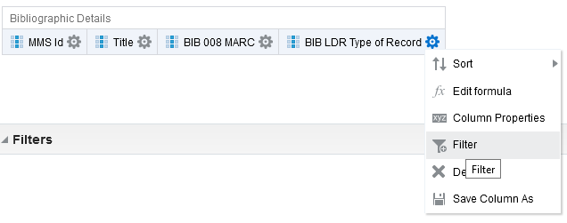
Filtering by pos. 6 of the LDR (type of record)
Step 5: Perform the filter

Slide 26
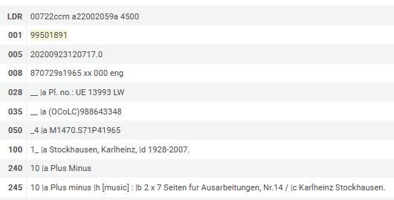
Filtering by pos. 6 of the LDR (type of record)
See results
This is the record viewed in Alma

Slide 27
xxx@exlibrisgroup.com

